Slide 1



Predictive Model for Data Professionals' Salaries
Project Overview
Presented by Vagdevi

Slide 2
Project Overview
•Problem Statement:
•Salaries in the field of data professions vary widely based on factors such as experience, job role, and performance.
•Accurately predicting salaries for data professionals is essential for both job seekers and employers.
•Mission:
•Build a predictive model for salaries of data professionals.

Slide 3
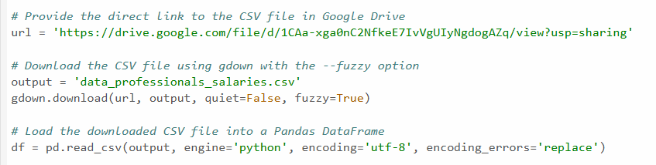
Data Acquisition
•Downloading Data from Google Drive
•Loading Data into a DataFrame

Slide 4
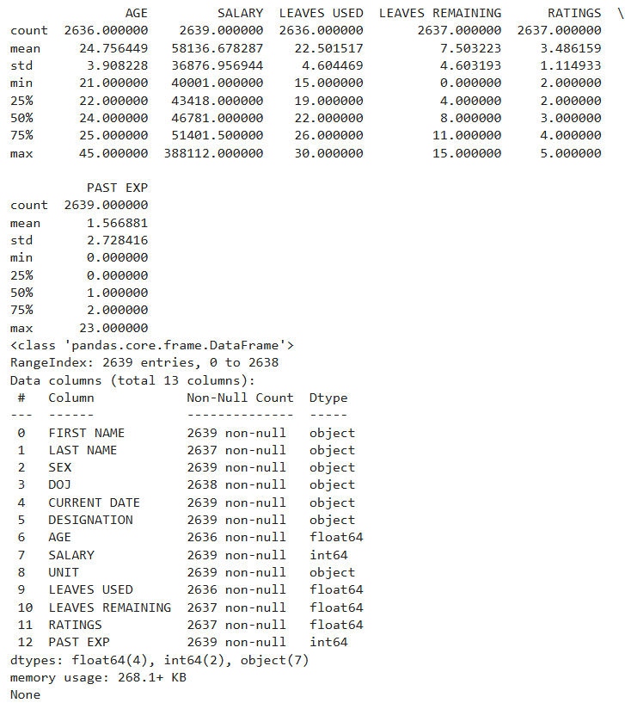
Exploratory Data Analysis (EDA)
•Summary Statistics

Slide 5
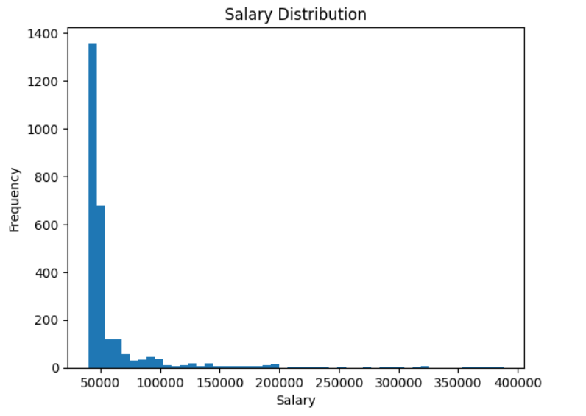
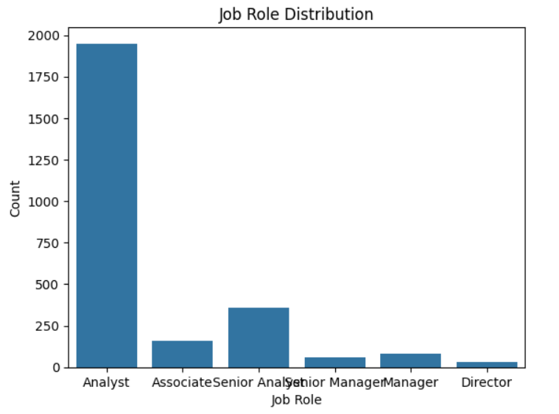
•Data Visualizations:
1.Salary Distribution
2.Job Role Distribution

Slide 6
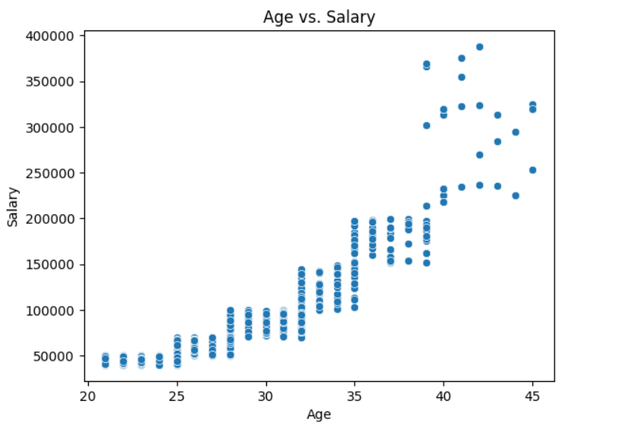
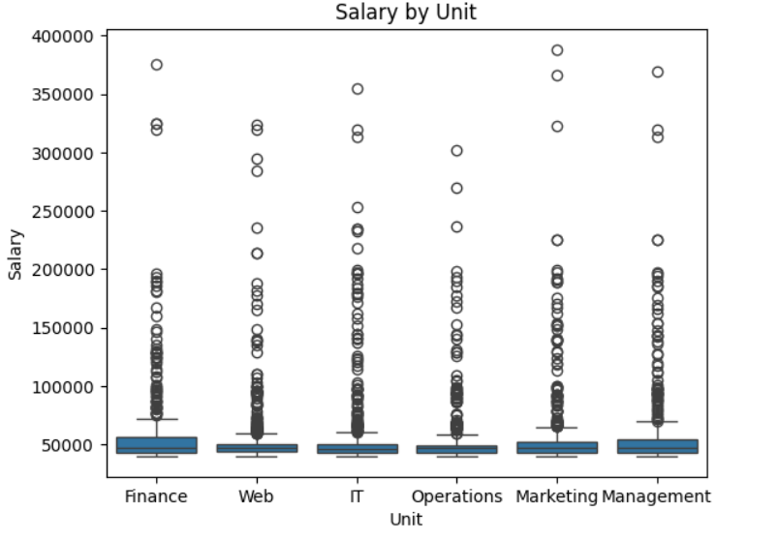
3.Age vs. Salary
4.Salary by Unit

Slide 7
Data Preprocessing & Feature Engineering
•Encoding Categorical Variables
•Handling Missing Values
•Scaling Features
•Creating New Features
•Transforming Existing Features

Slide 8
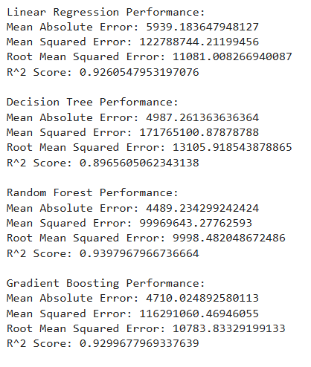
Model Training and Evaluation
•Splitting Data
•Training Models
•Evaluating Models
•RMSE, MAE, MSE, R-squared

Slide 9
Model Deployment
Define a pipeline that combines preprocessing and the model
Building Flask Application
Creating Endpoints
Exposing Server with ngrok
Testing the API

Slide 10
Thank
You

